Slide 1
Monthly Takeaways and Recap
Krishnaraj Thadesar
Associate Software Developer Intern
24th December 2024

Slide 2
Agenda
Introduction
Work Ongoing and Done
Software and Applications Used
Work Ongoing and Done
Technical and Personal Learnings
Accomplishments and Gratitude

Slide 3

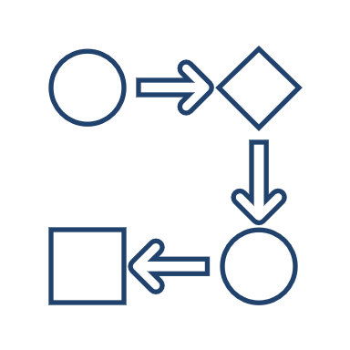

Core Work Ongoing
Cabin Configuration Screen
Onboarding
APIs
Make the Cabin Configuration Screen
Onboarding a new member
Backend stories for APIs

Slide 4



Core Work Month 1
Demo Project
Processing Files
Designing Schema
Started with making a demo project to get a hands-on about our tech stack
Process Input files given by client.
Working with my team to design the schema, and learning in depth about it in the process.

Slide 5

Core Work Month 2
Process 2 new Files
Analyze Files
Angular Training
Out of Order and Historical Pricing files need to be processed
Perform basic analysis on the file, and try to find any potential errors or edge cases it may have
Attend and learn Angular for building frontend.

Slide 6
Core Work Month 3
Writing API for Forecasting
File Processing workflow
Learning about APIs
Write API calls for Forecasting Page
Try to fix logical inconsistencies in entire file to dB workflow
Learn about best practices with writing APIs and DTOs

Slide 7
Core Work Month 4
Writing API for Pricing
And Configuration screen
Working on UI
Learning UI code practices
Write API calls for Pricing screen, along with cabin configuration screen
Writing a new screen – cabin configuration
Angular code practices, CSS, and frontend methodologies

Slide 8









Software and Applications Used

Slide 9
Technical Learnings
Treat small changes with the same respect that you treat big ones.
Don’t take things at face value. Don’t assume things someone tells you.
Don’t commit important PRs when you are sleepy.

Slide 10
Technical Learnings Month 4
When a lot of files are conflicting, instead of getting frustrated, its best to resolve it with patience, than losing it. A few patient minutes can avoid hours of work later.
Test your work on dev and higher environments before marking it as done.
Use sonar cloud, and other warnings and code checks intellij offers.
When writing questionable code, try to write it as close to origin of data as possible. That makes it easier to debug.
In using a relational database, normalization is preferred over slight complexity. Simple queries are better than joins, even if you have to make a few tables for it.

Slide 11
Technical Learnings Month 3
While seemingly obvious, simpler solutions to problems are better than more complex ones.
Its important to know what each line and function of your code does. You can work without this too, just not as efficiently.
Indexes are more important in sql than we give them credit for. They are a topic worth learning deeply about.
Best Practices:
Use constants on left side of your “=” in if statements.
Use .equals or such function wherever you can as opposed to symbols.
Use objects instead of primitive values. They are null safe.
Try to use immutable types wherever you can.

Slide 12
Technical Learnings Month 2
All of your code logic for any function must reside within the height of your monitor, and you mustn’t have to scroll. If you do, write functions.
Try to reduce any duplication of code.
Try to induce the feeling of being a developer in your team, rather than a temporary helper.
It is better to do one thing with accountability than 4 things that you aren’t sure about. Reliability > versatility.
Do not love your code.
Do not say something doesn’t work, without completely making sure it doesn’t.
Outline your test cases before you write them, name the functions first.
Merge with main every now and then if your PRs last long.

Slide 13
Technical Learnings Month 2
Every now and then, make sure to check everything is up and running.
Make small Pull requests. Even smaller commits. Try to catch it up with your stories and subtasks in stories.
Simplify things – Complex is fun and exciting. It has a sense of awe. Simple code is understandable and therefore maintainable.
Breaking things down and doing things step by step is always better than combining a few things together. Its okay if work happens slower than expected, as long as it happens right.
Write test cases as soon as you finish writing a file.
Support using a pre-tested pre-existing famous library instead of writing any logic by yourself, only to have more things to test.
Try to reduce the usage of if-statements wherever you can. More branches.

Slide 14
Technical Learnings Month 1
Better code style and technique.
Farsightedness with regards to code, what it will go through, and how to make it robust.
It takes time to design, and its often worth spending that time in the beginning than to regret spending it later, and spend time fixing it instead.
Writing good code that doesn’t work is harder than writing bad code that works, and it is this that makes personal projects easier in comparison to enterprise applications, despite achieving the same result at small scale.

Slide 15
Personal Learnings
Don’t keep your phone on silent.

Slide 16
Personal Learnings from past few months.
Patience is an underrated virtue, both in developers and in people.
It is often better to focus on learning something well in the beginning rather than to focus on finishing something hastily.
It is in fact true that we don’t even know how much is unknown to us, and available to learn.
It is better to listen and observe, than to intervene and speak, unless prompted to.
Being a good listener goes a longer way than we give it credit.
Before you ask request someone anything professionally, make sure they haven’t already done it.
When asked anything, be honest about it. Even if the answer sounds disappointing.
Before starting a meeting, its good to walk through what you are going to say.
In scrums, its good to have a few succinct conclusions instead of a story.

Slide 17
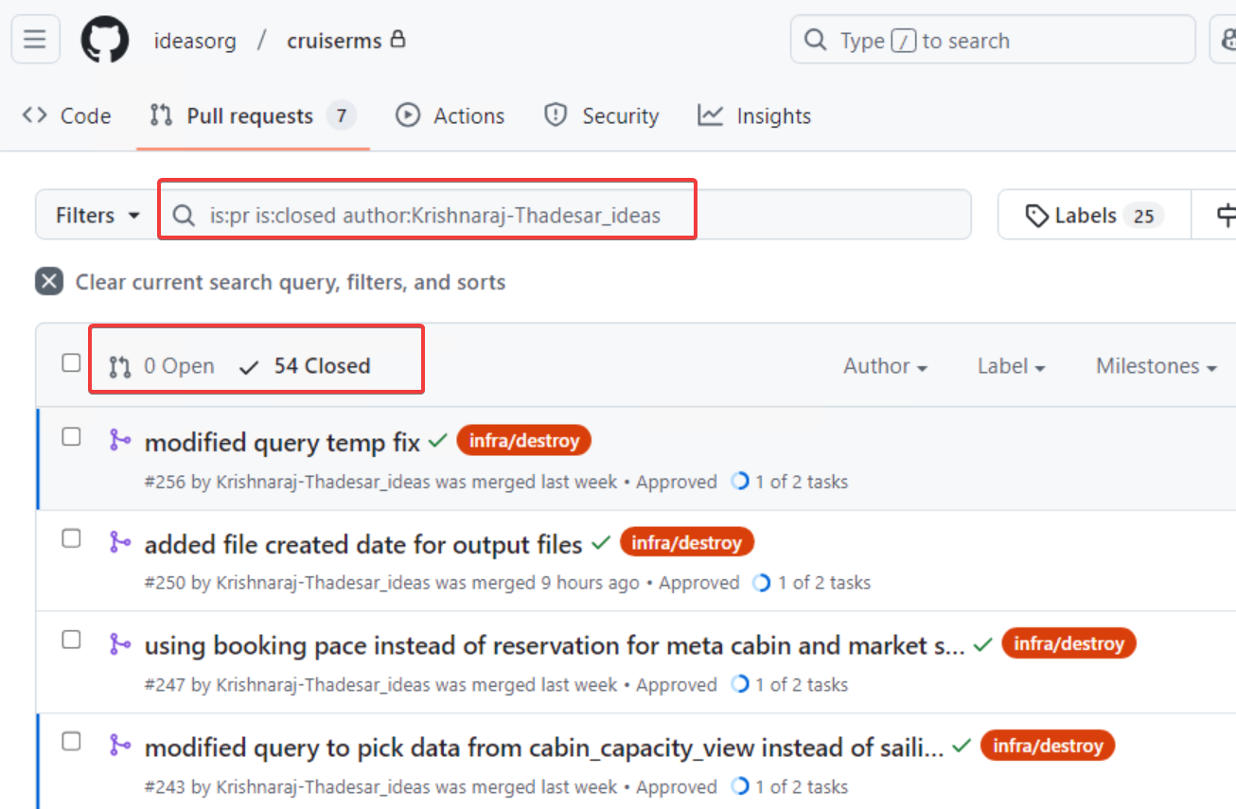
Accomplishments – Merged PRs

Slide 18
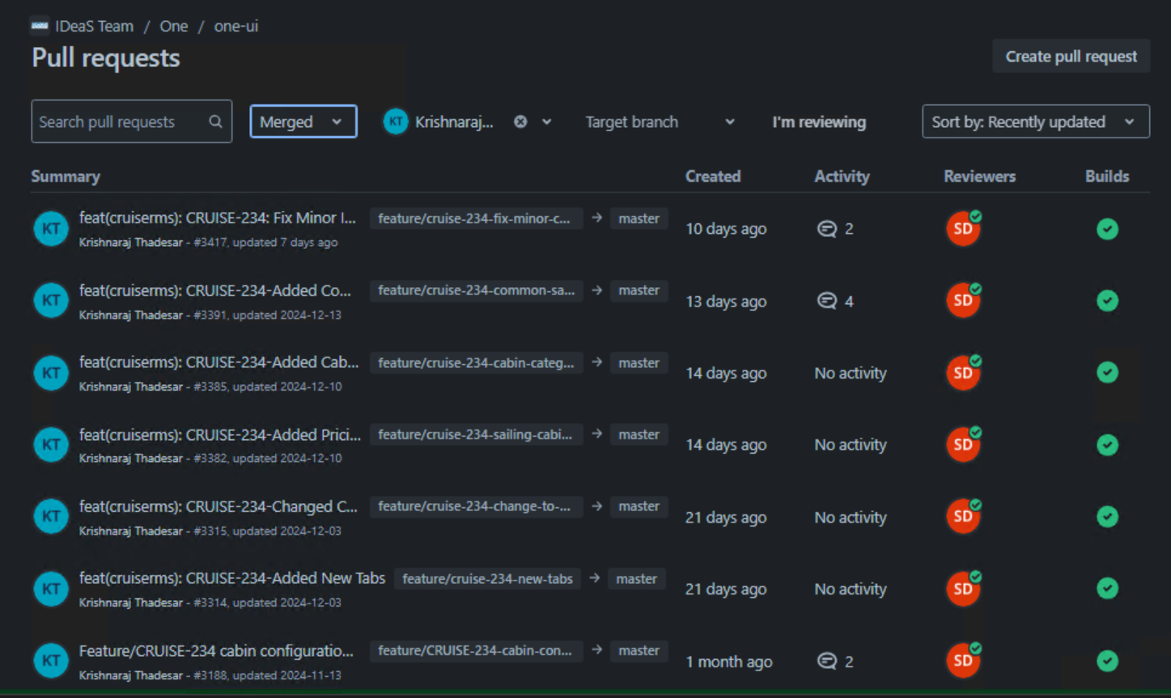
Accomplishments – Merged PRs

Slide 19
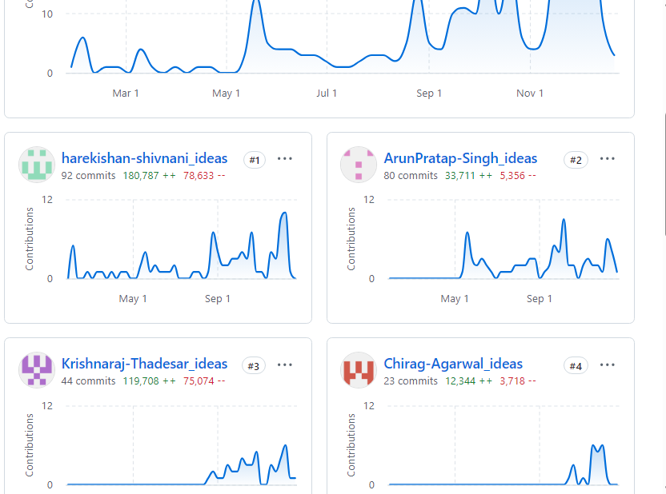
Accomplishments – Contributions

Slide 20

Look Back

Slide 21
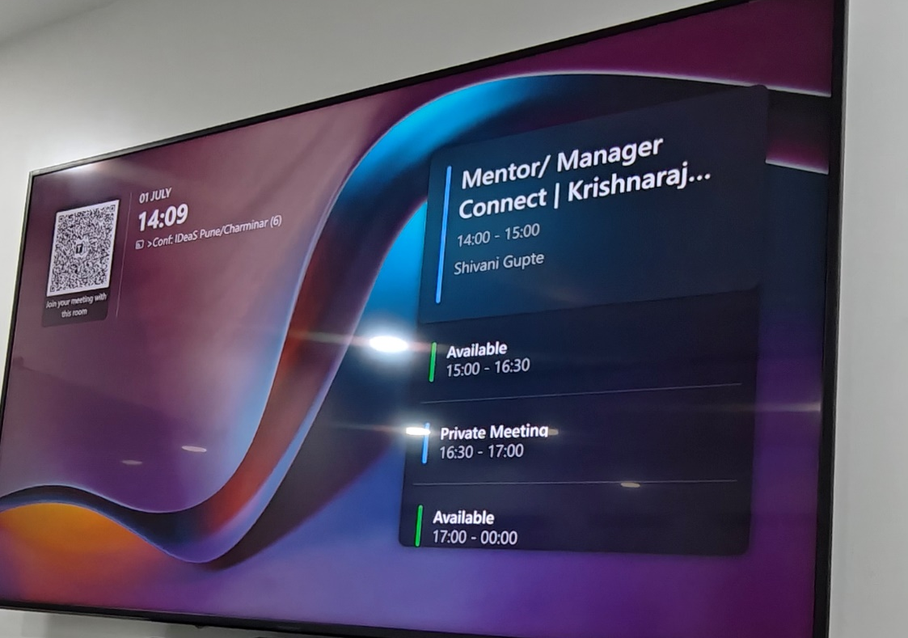

Slide 23
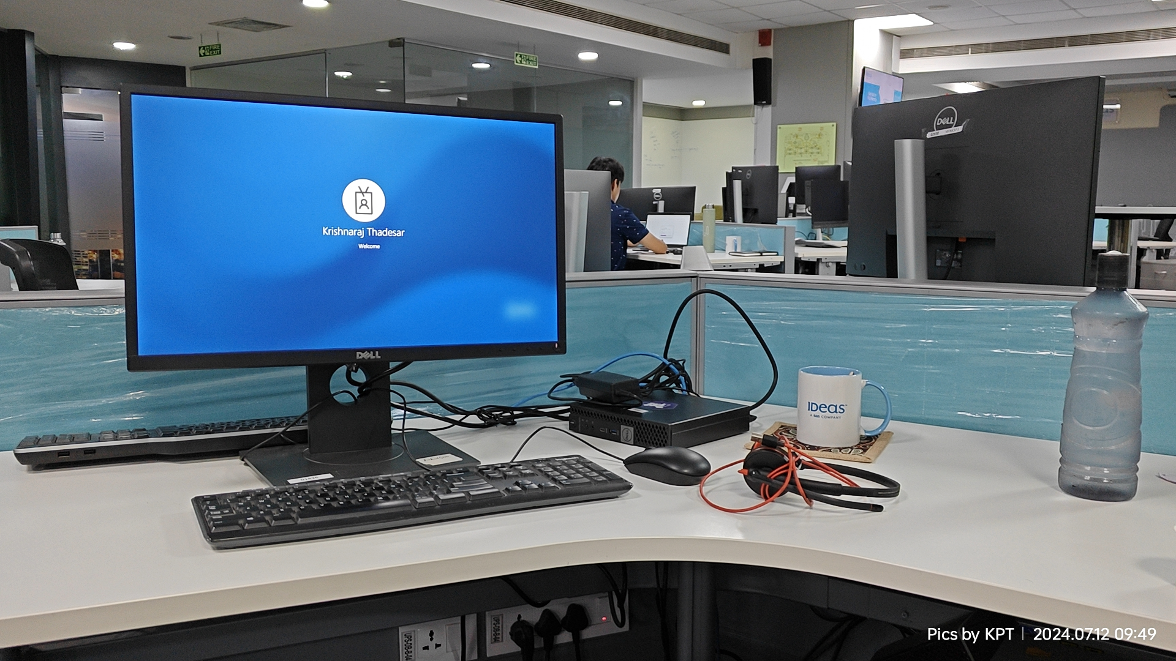

Slide 24
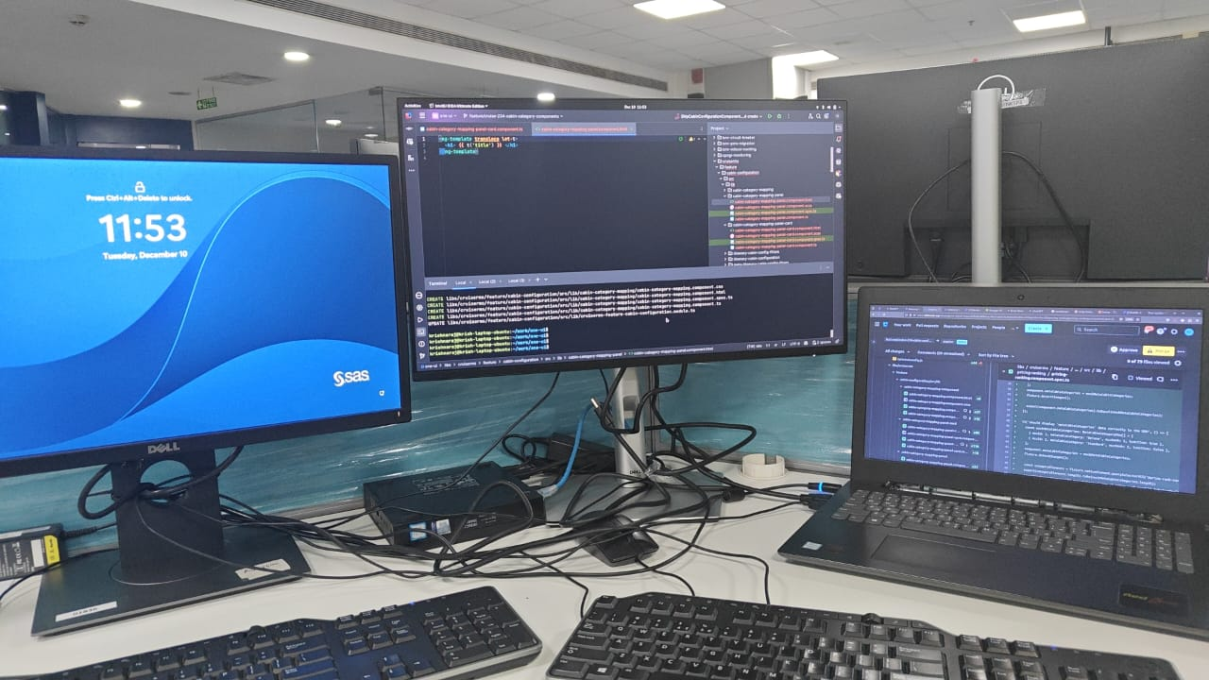

Slide 25
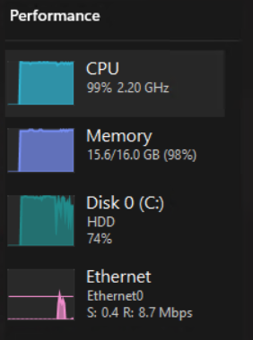
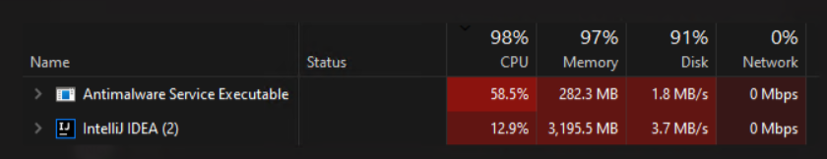

Slide 26
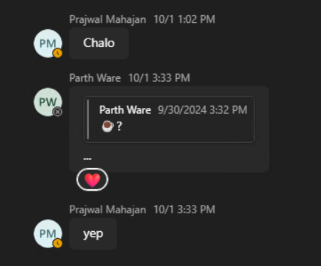
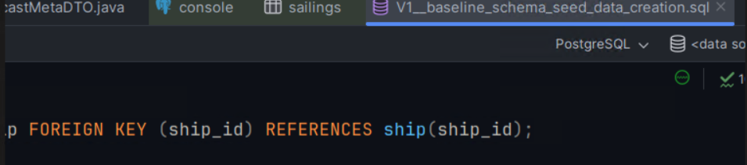
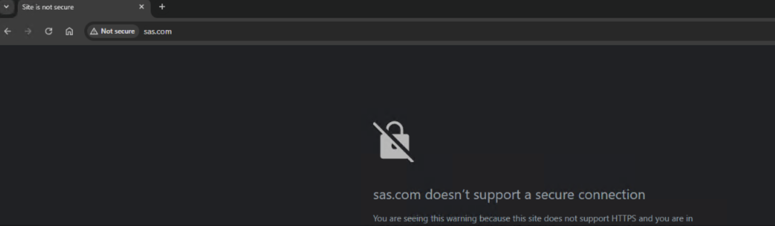

Slide 27
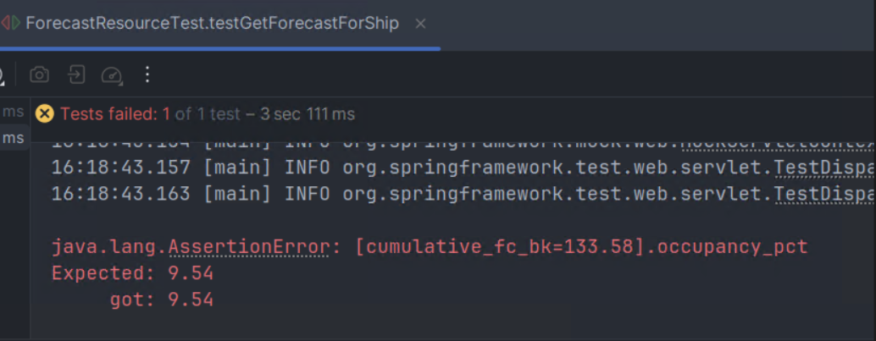

Slide 28
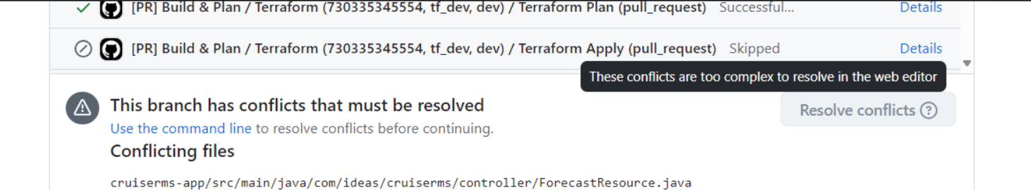
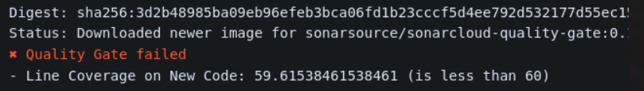

Slide 29
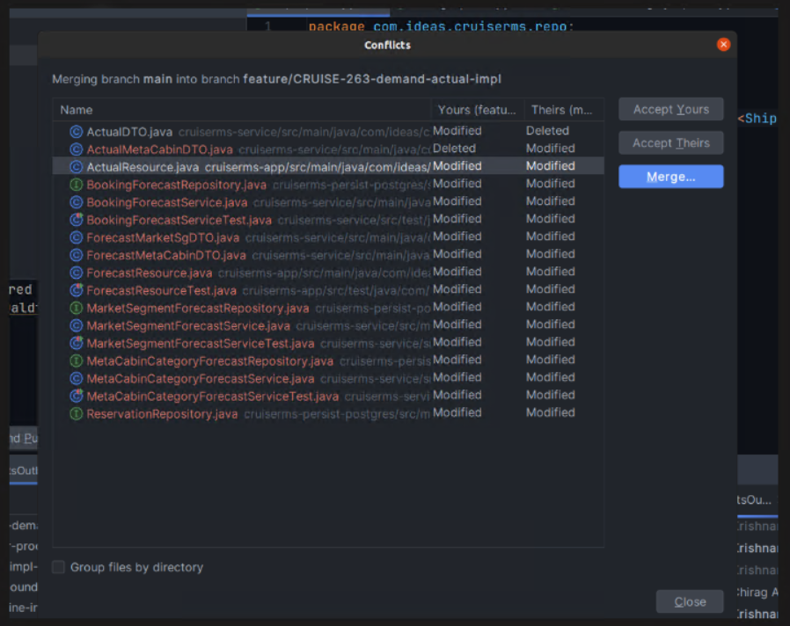

Slide 32
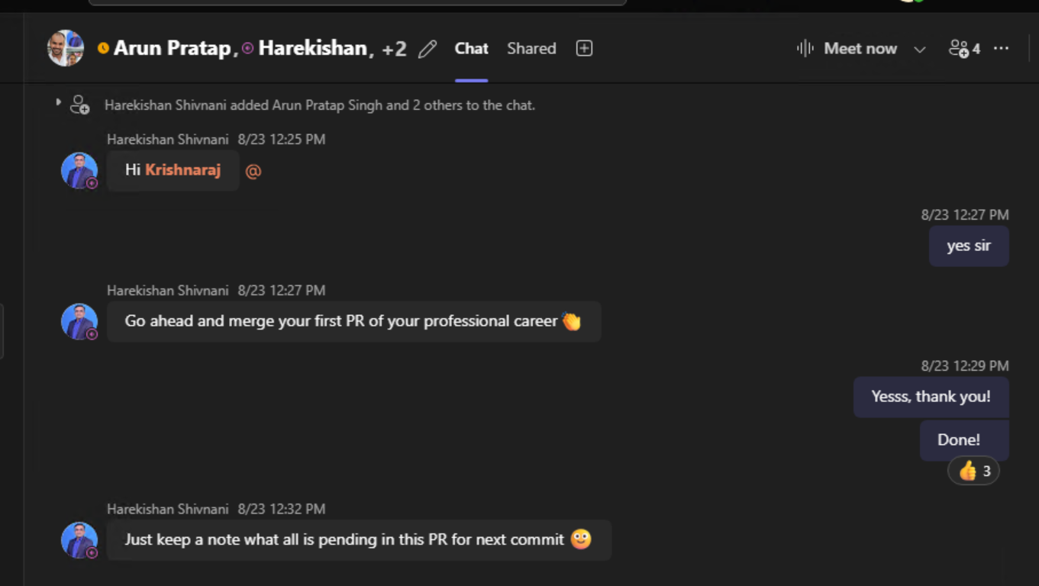

Slide 33
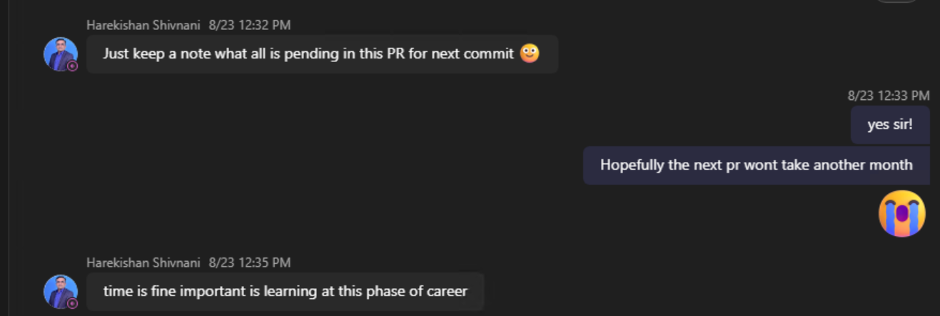

Slide 34
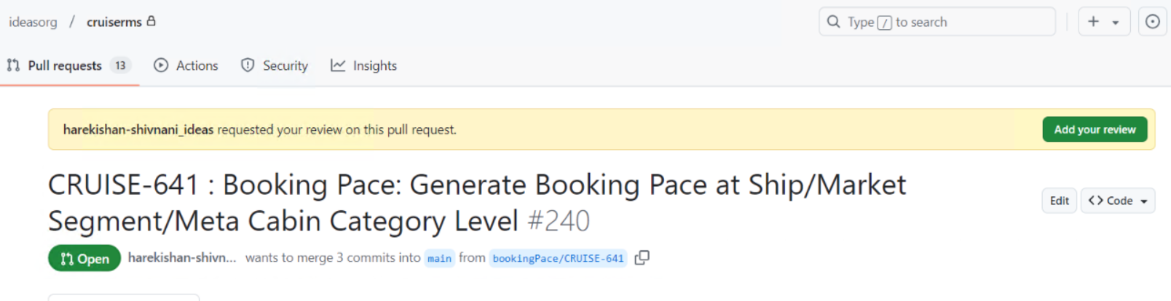

Slide 35
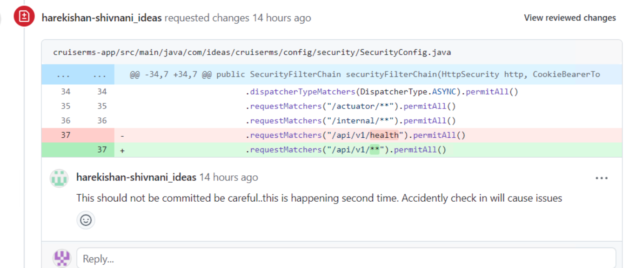

Slide 36
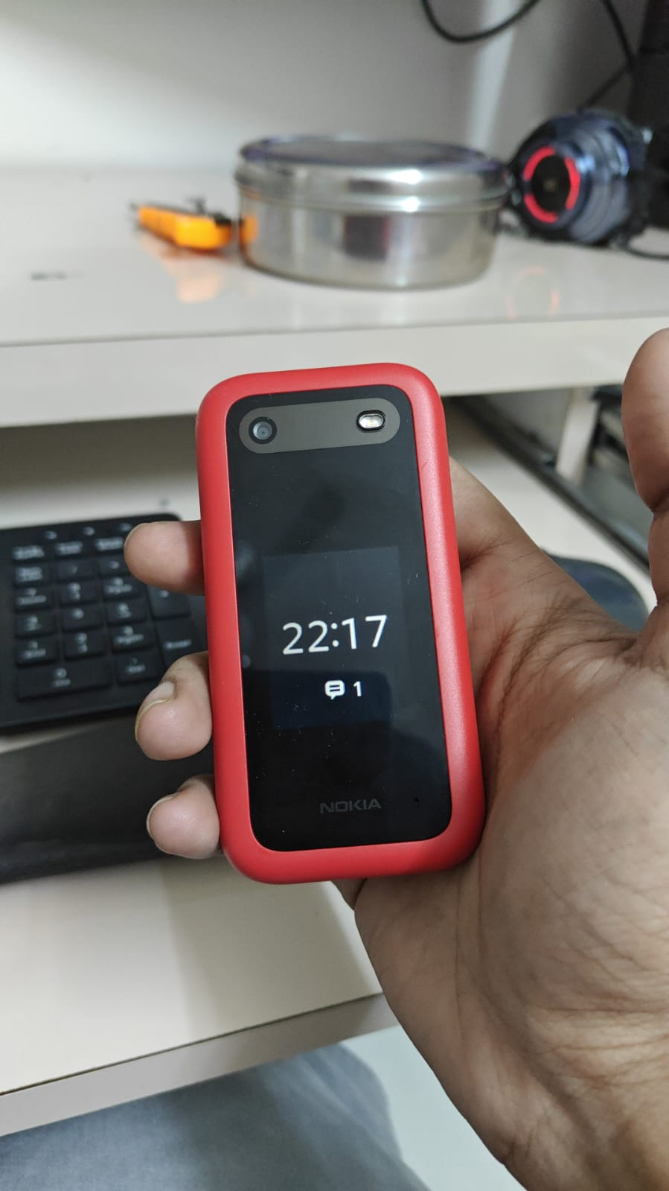

Slide 37
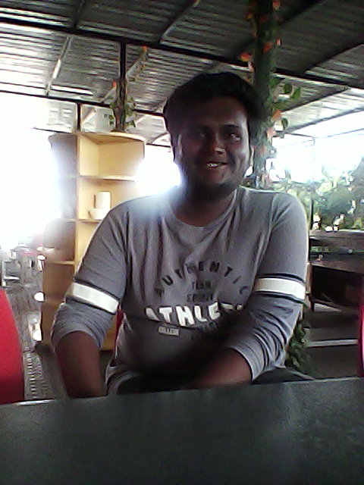
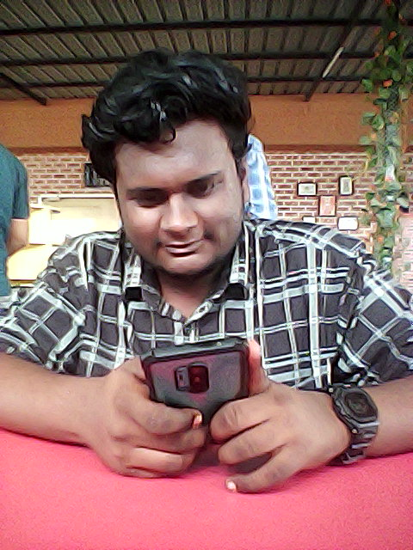
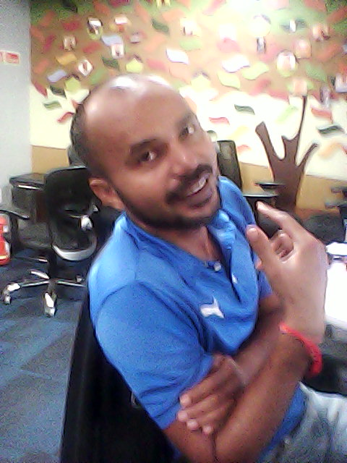
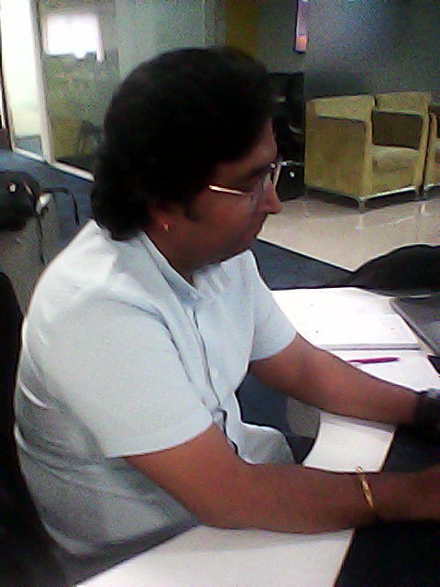
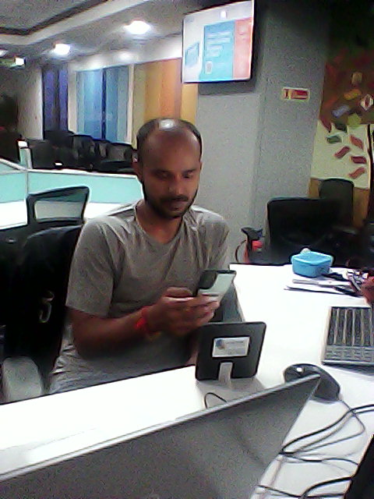
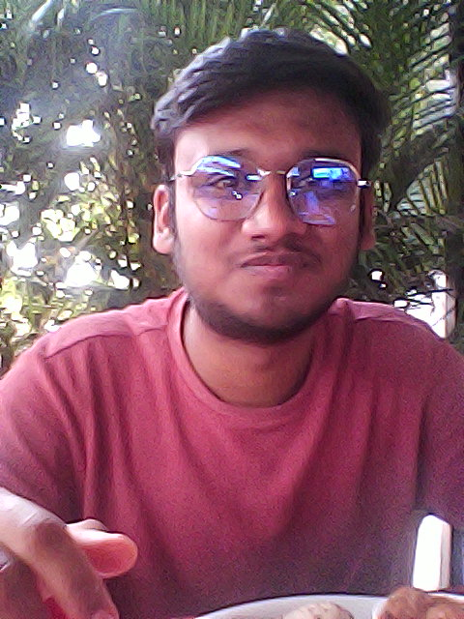

Slide 38
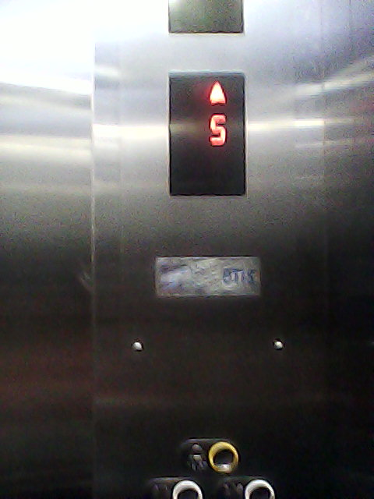

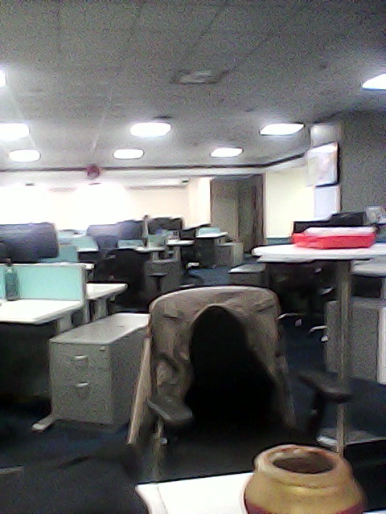
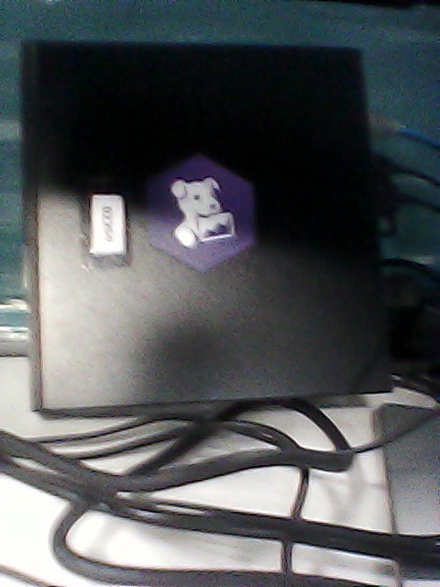

Slide 39
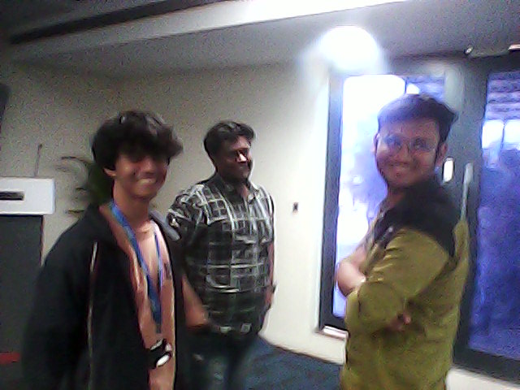

Slide 40
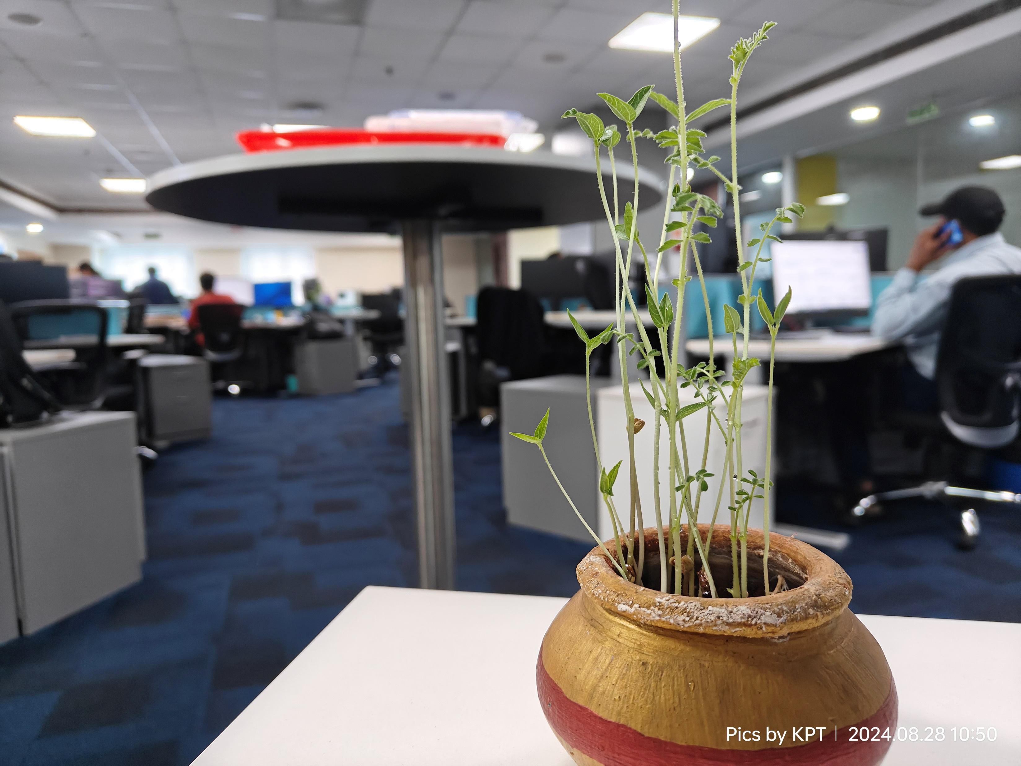

Slide 41
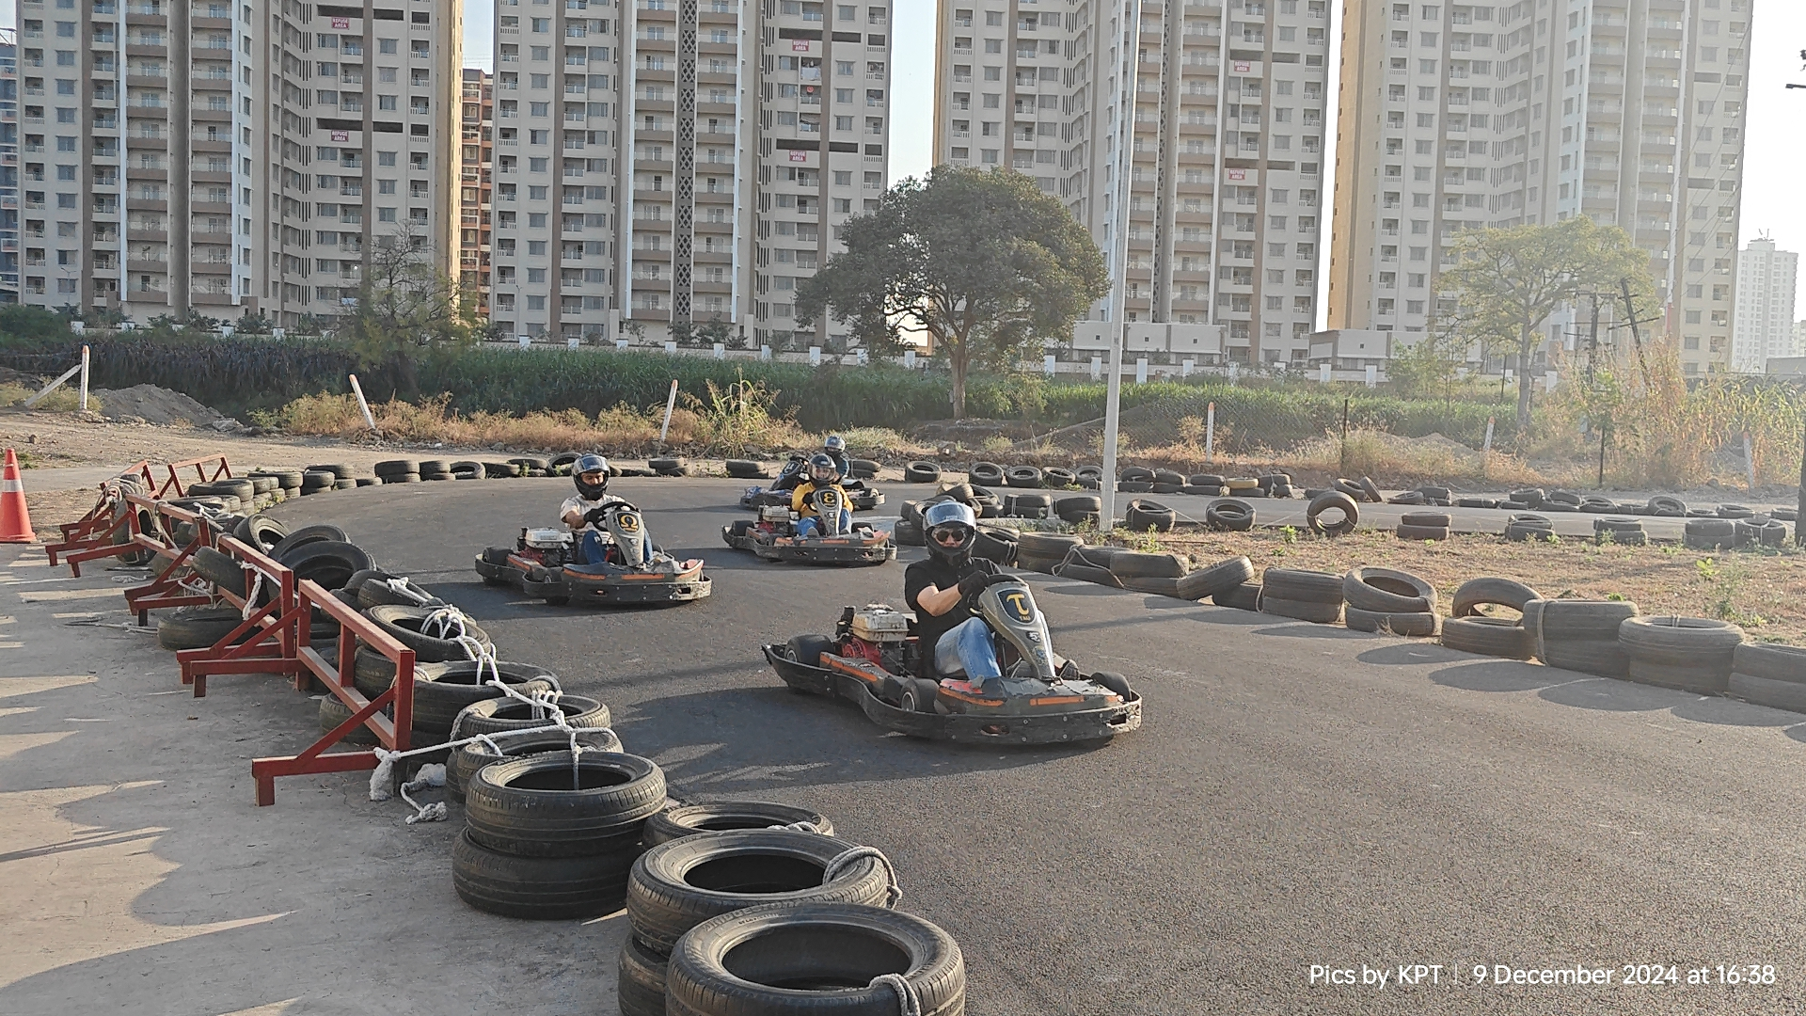

Slide 42
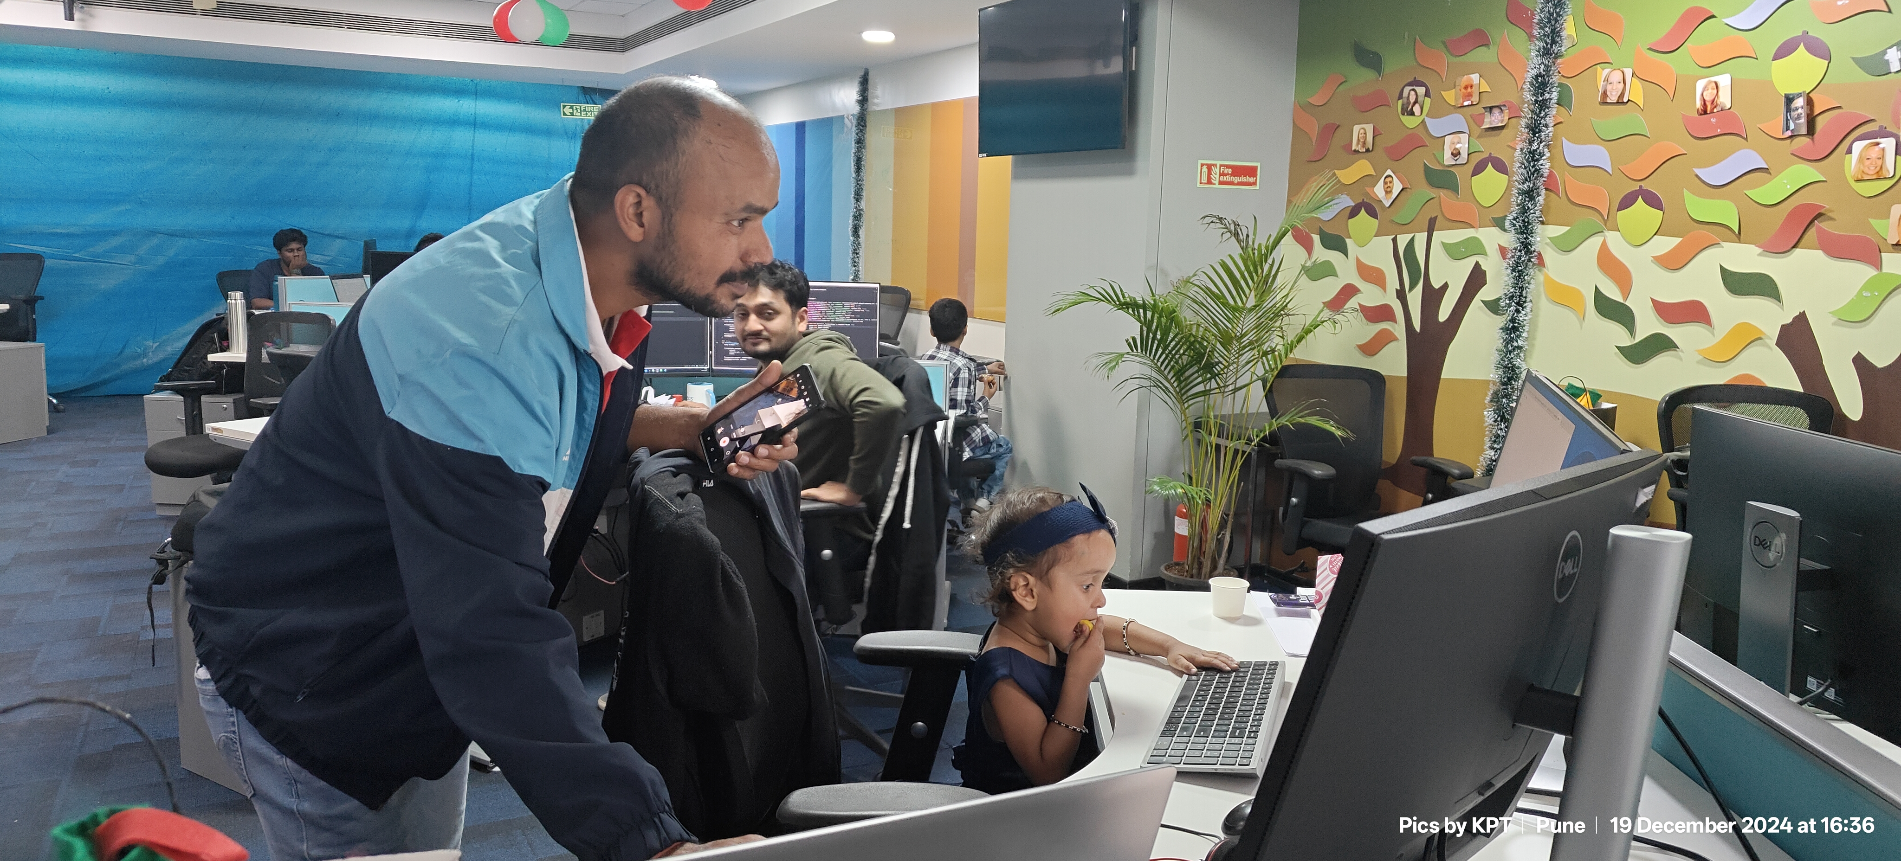

Slide 43
Thank You
Continued gratitude to Mr. Arun Pratap Singh, Mr. Harekishan Shivnani, and Mrs. Sunanda Duttasen for their over the clock availability for any and all help I need at any time.

